Slide 1
Campus Connect: The Community App
Team Code-Astra | CIEL Kingston VibeAIthon 2025
Team Members:
HARIGANESH S, SHARAN RAJ H, VIGNESH S, RAJESH I, SHARMILA V

Slide 2
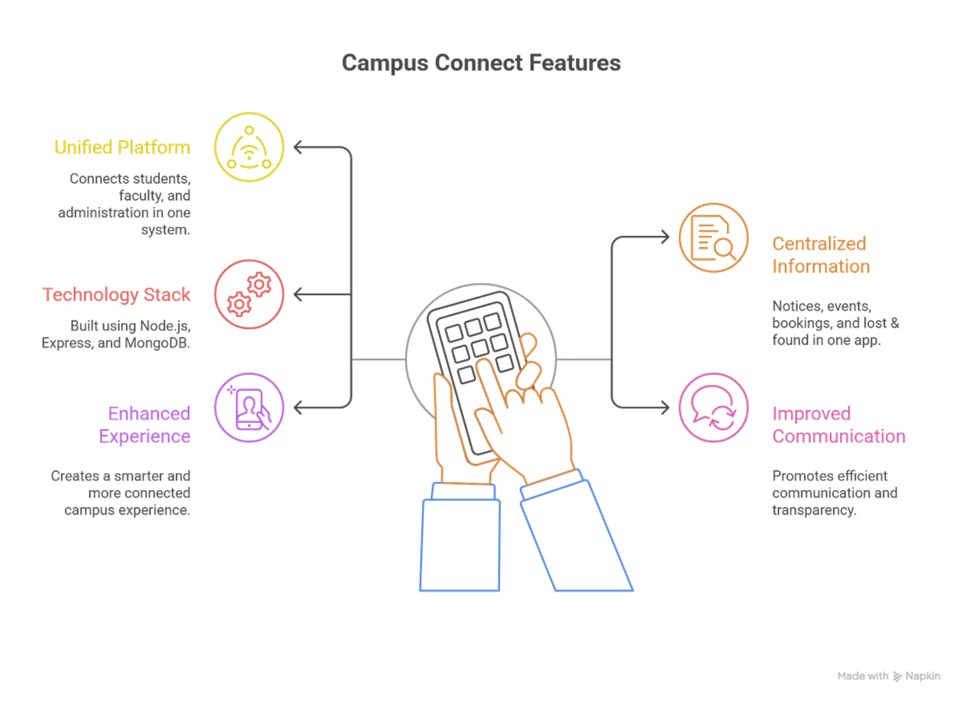
Introduction:
Campuses often face scattered communication — multiple WhatsApp groups, paper notices, and missed updates.
Campus Connect is a smart digital platform that unifies students, faculty, and administration in one system.
It centralizes notices, events, bookings, and lost & found into a single mobile + web app.
Built using Node.js, Express, and MongoDB, ensuring real-time data and smooth performance.
Promotes efficient communication, transparency, and a smarter campus experience.
Reimagine your campus. Redefine your vibe. ✨

Slide 3
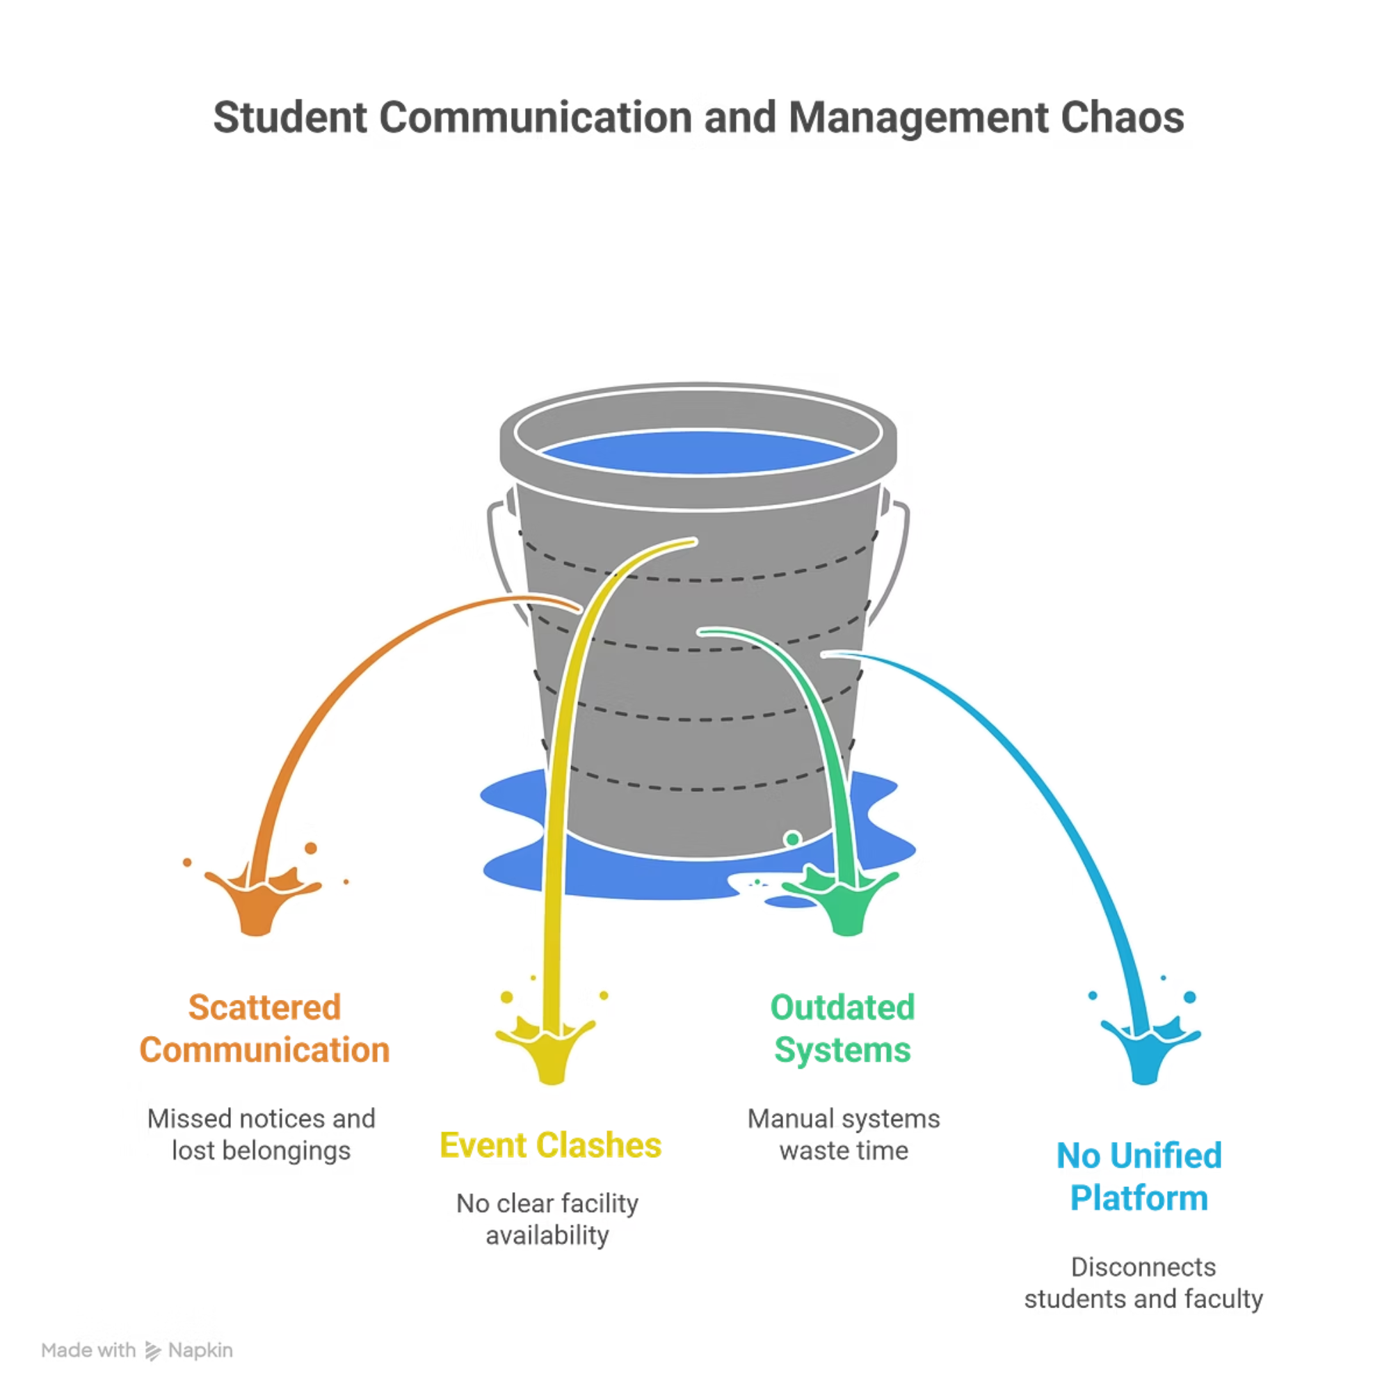
Project Plan:
Students face chaos in communication — scattered WhatsApp groups, missed notices, and lost belongings.
Event clashes, no clear facility availability, and outdated manual systems waste time.
There's no unified digital platform that connects students, faculty, and campus services in real time.
Result: Miscommunication, confusion, and inefficient management.

Slide 4
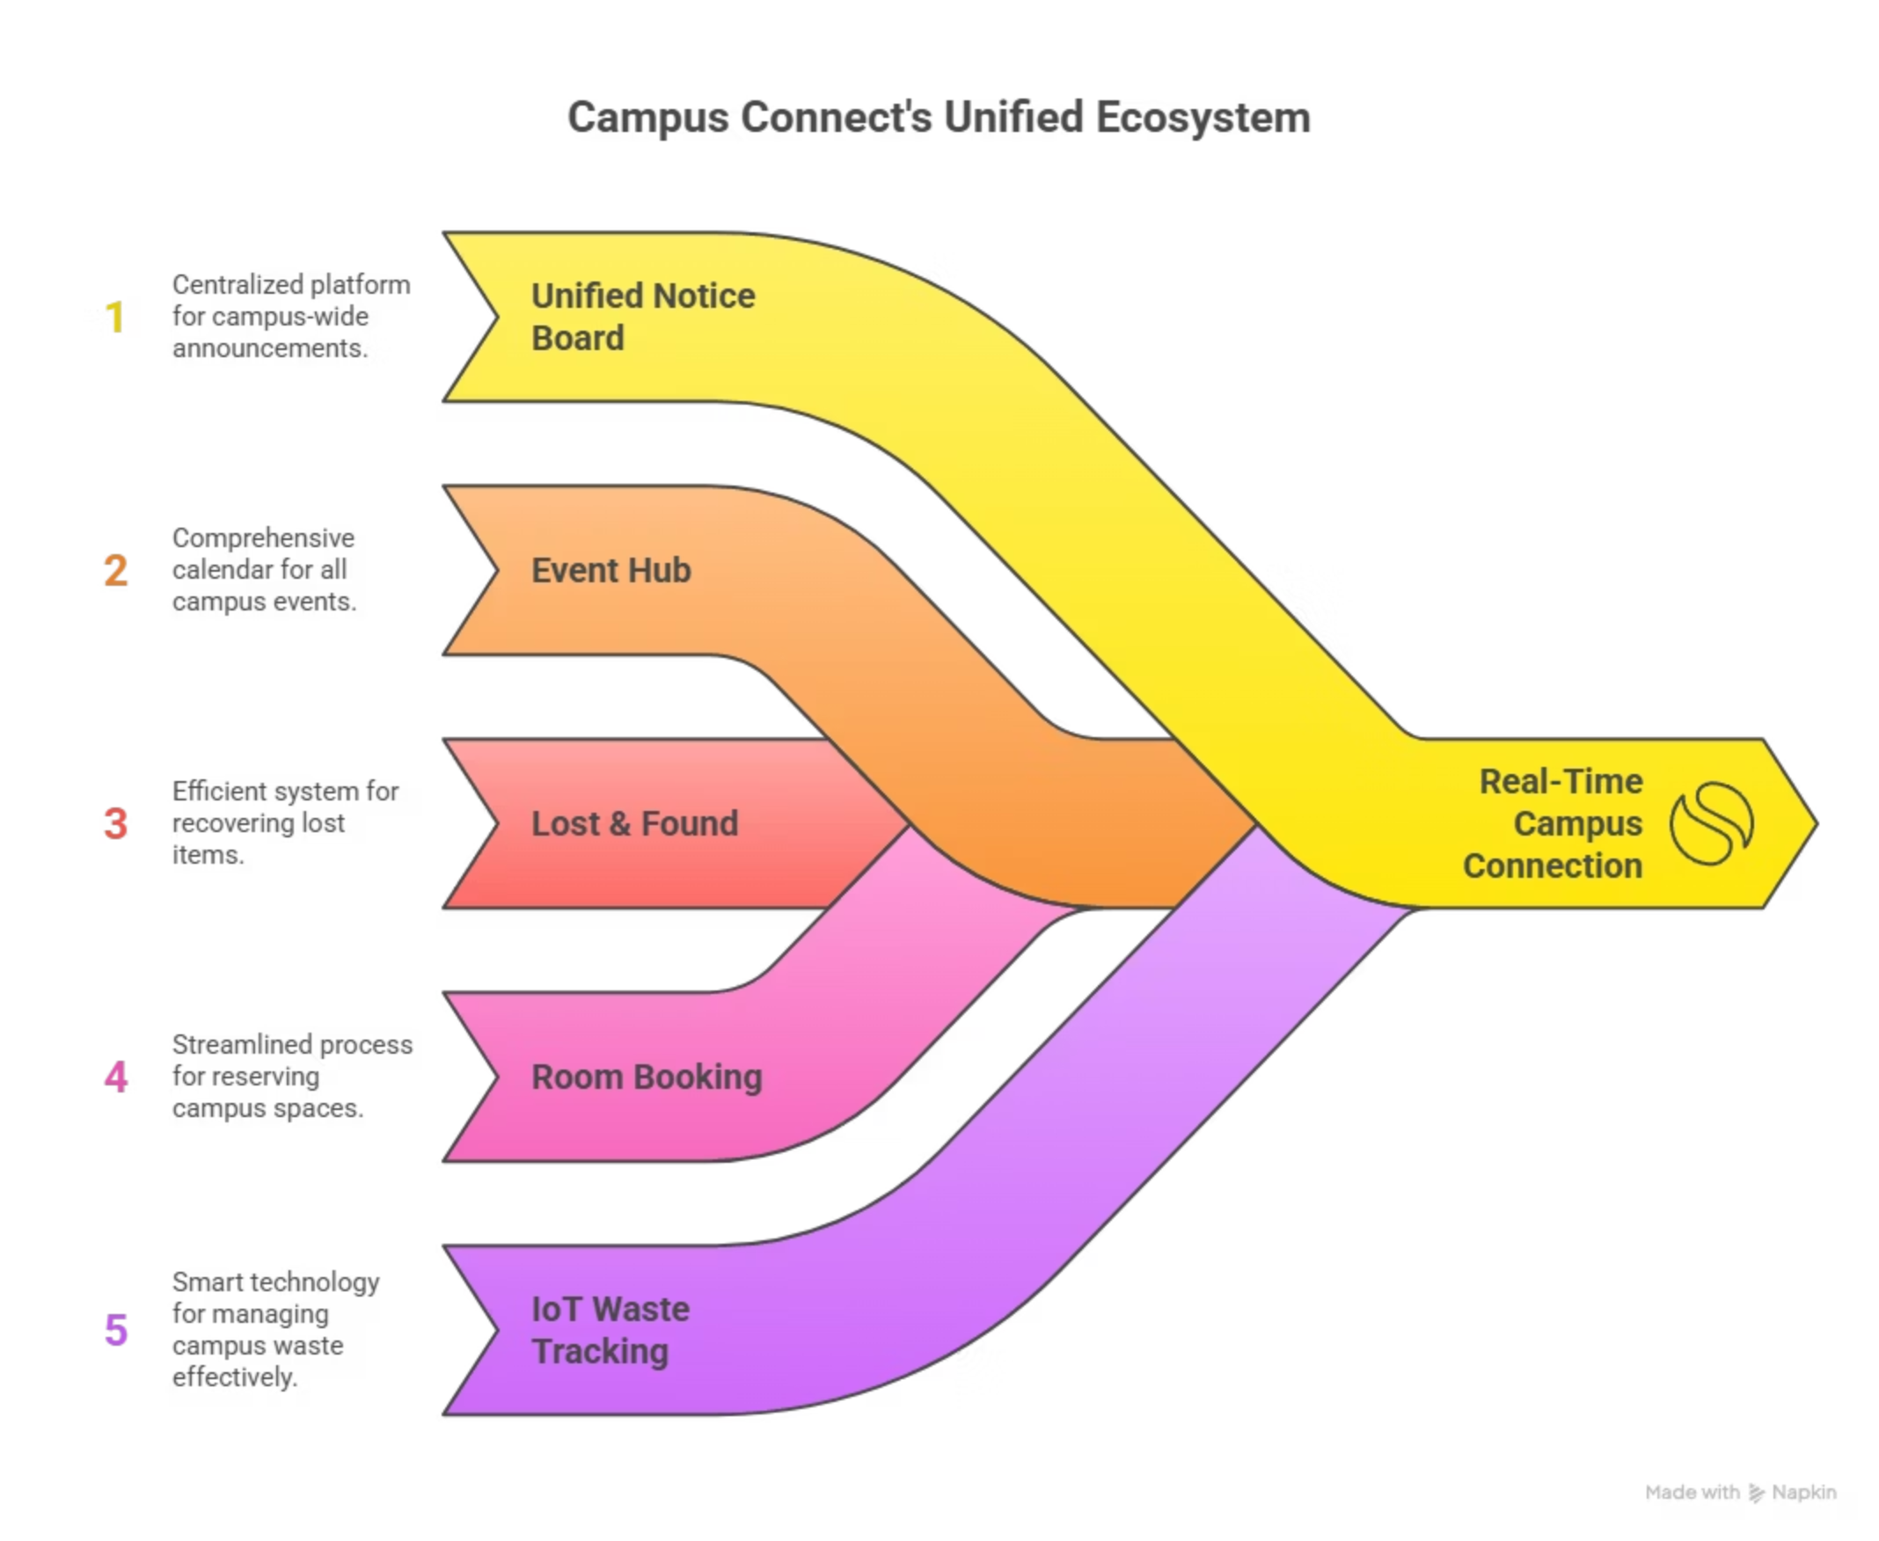
Proposed Solution:
Campus Connect is an all-in-one smart campus management app that centralizes announcements, events, and resources.
Mobile + Web app for students, faculty, and admin.
Unified notice board, event hub, lost & found, and room booking.
Optional IoT add-on for smart waste tracking.
Goal: Real-time connection. Zero chaos. Maximum vibe.

Slide 5
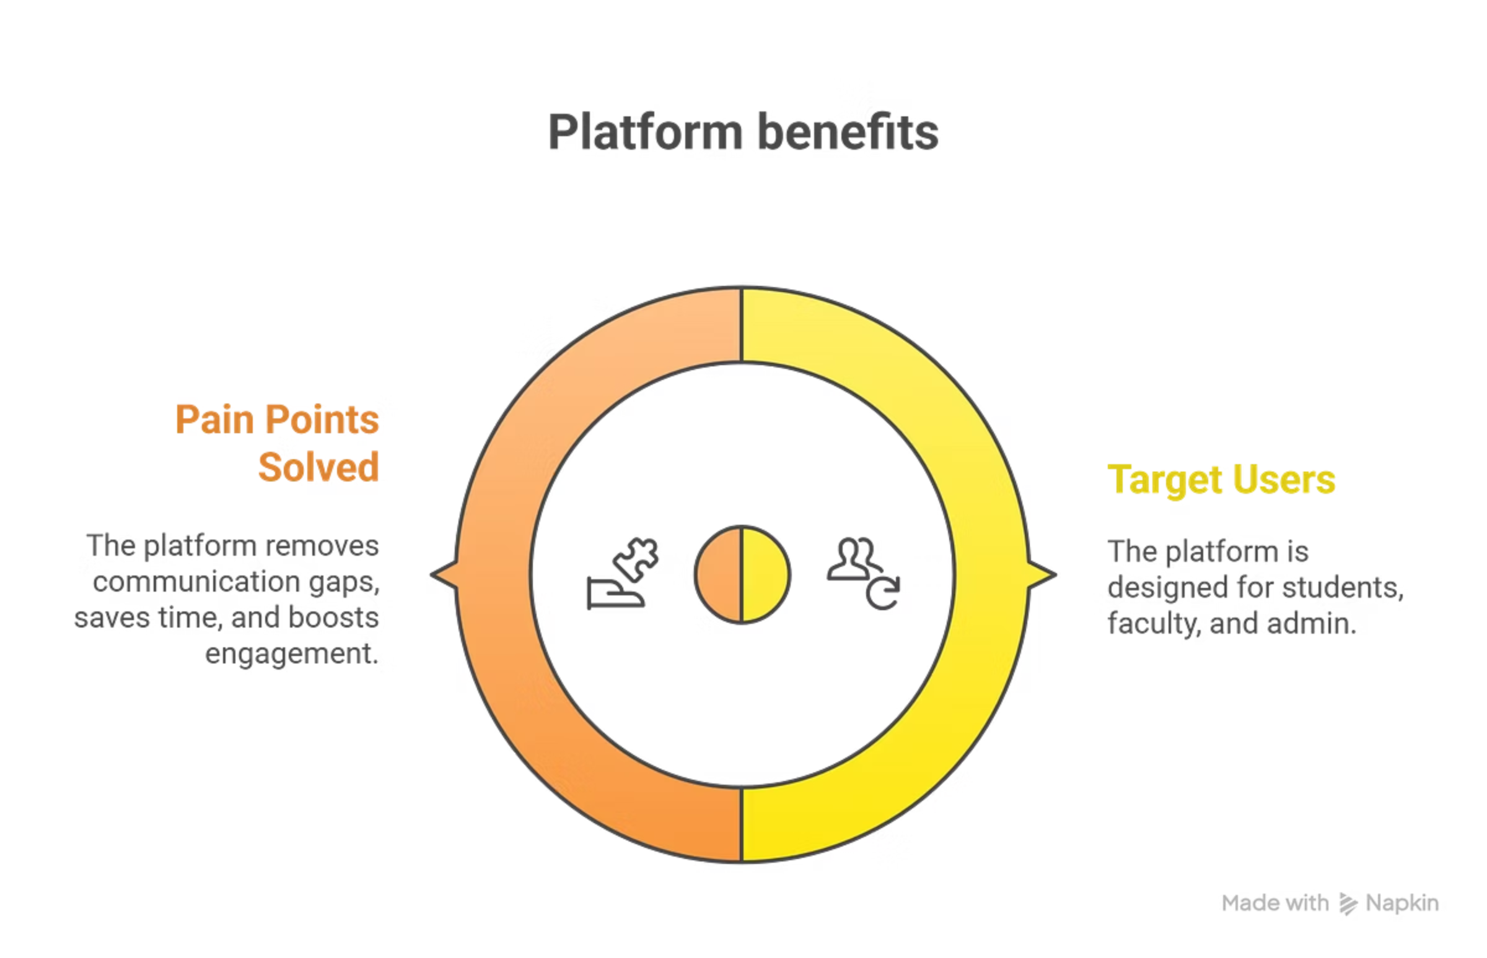
Benefits (Addressing User Need):
Target Users:
🎓 Students – Stay updated and connected.
👩‍🏫 Faculty – Manage classes, notices, and bookings.
🏢 Admin – Track facilities and optimize resources.
Pain Points Solved:
Removes communication gap.
Saves time and effort.
Boosts engagement and transparency.

Slide 6
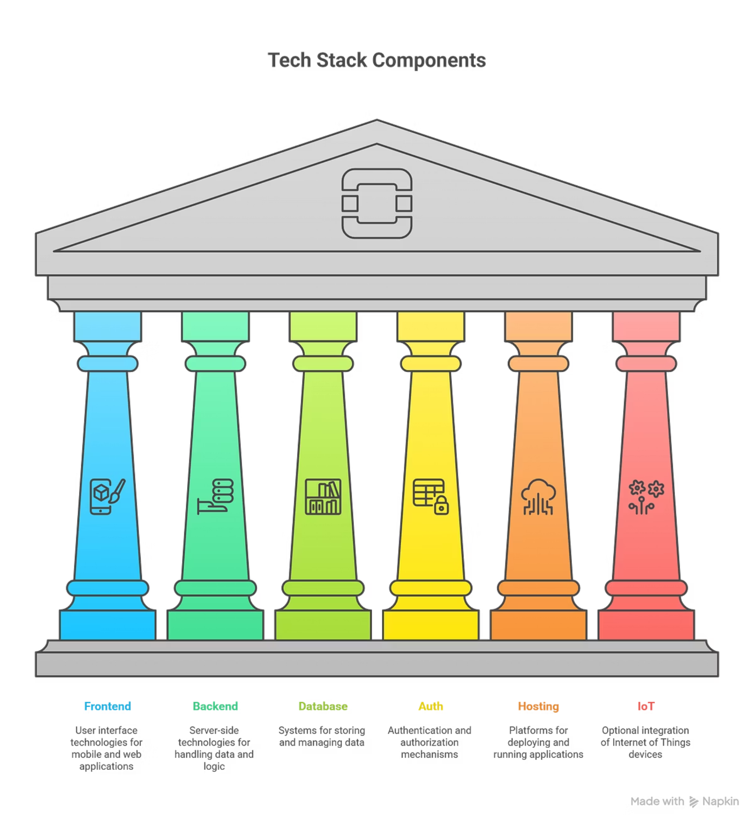
Feasibility (Can You Build It?):
Tech Stack:
Frontend: Flutter / React Native
Backend: Node.js / Firebase
Database: Firestore / MongoDB
Auth: Firebase Auth / JWT
Hosting: Firebase / Vercel
IoT (optional): ESP32 + Sensors
Architecture:
Users → Frontend → Backend APIs → Database → Admin Dashboard

Slide 7
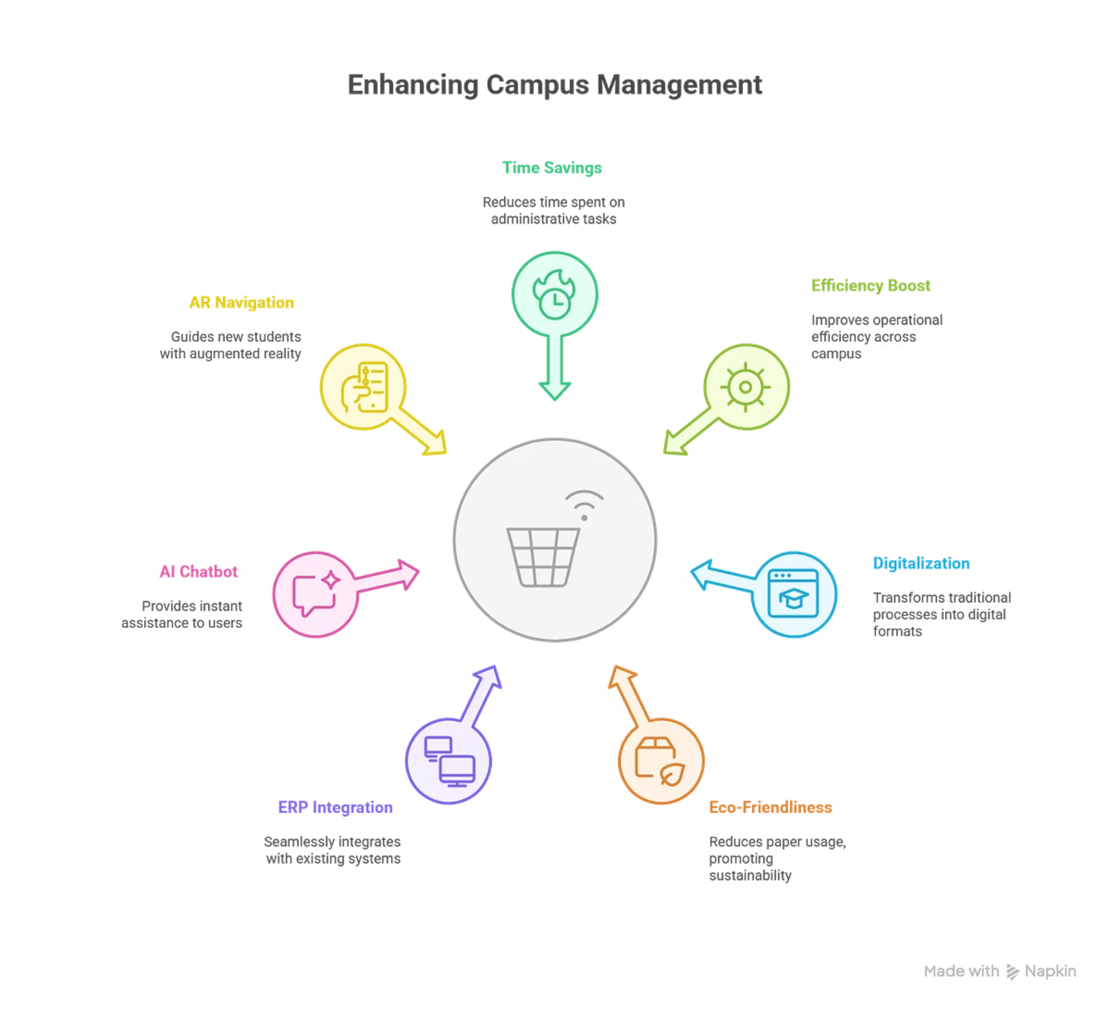
Viability (Is It Sustainable?):
Impact Model:
Saves time and boosts efficiency.
Digitalizes campus management.
Reduces paper usage — eco-friendly.
Scalability:
ERP integration.
AI chatbot for instant help.
AR navigation for new students.

Slide 8
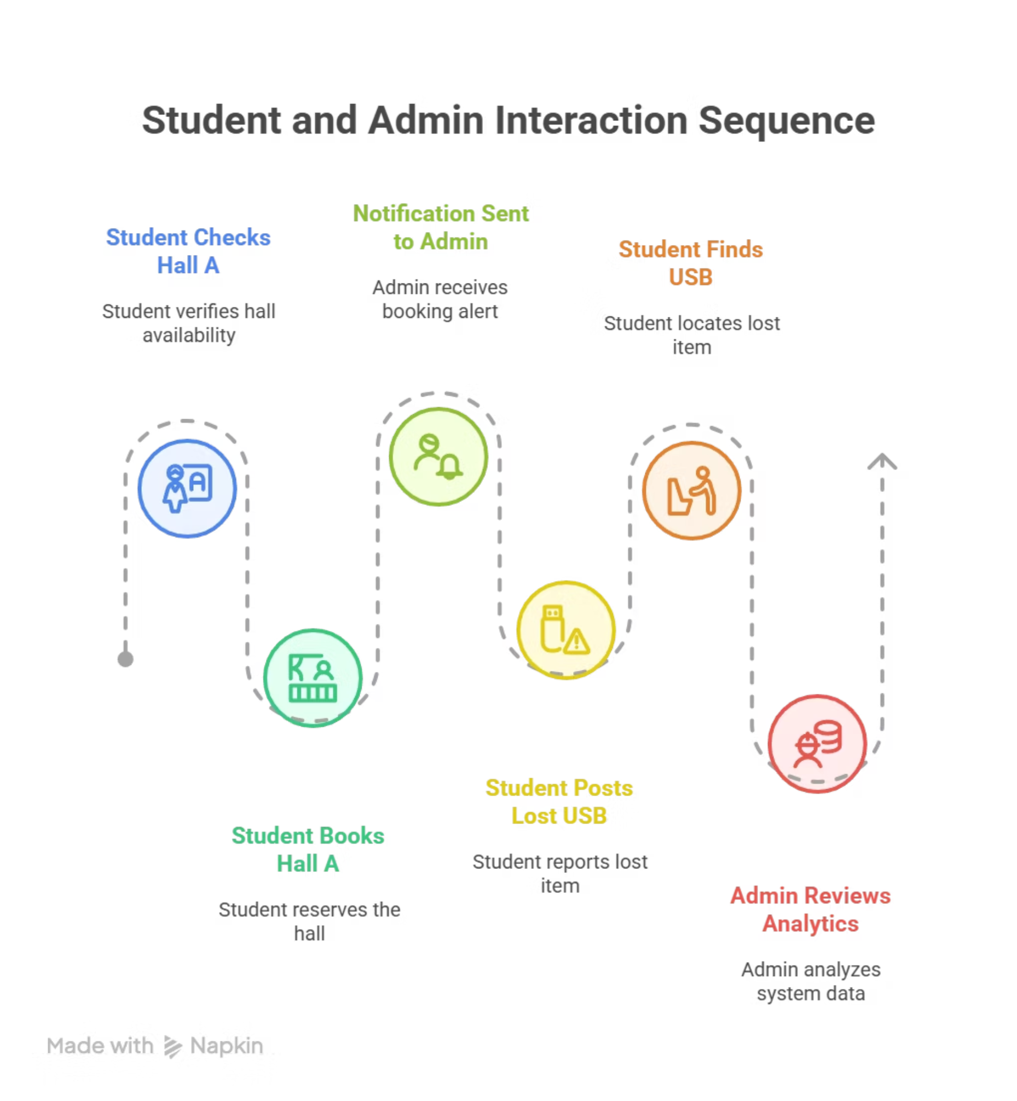
Prototype / Demo:
Scenario:
Student checks Hall A → sees it's free → books it.
Auto-notification sent to admin.
Later posts a lost USB → another student finds it via app.
Admin reviews analytics on dashboard.
Everyone's connected. Zero chaos.

Slide 9
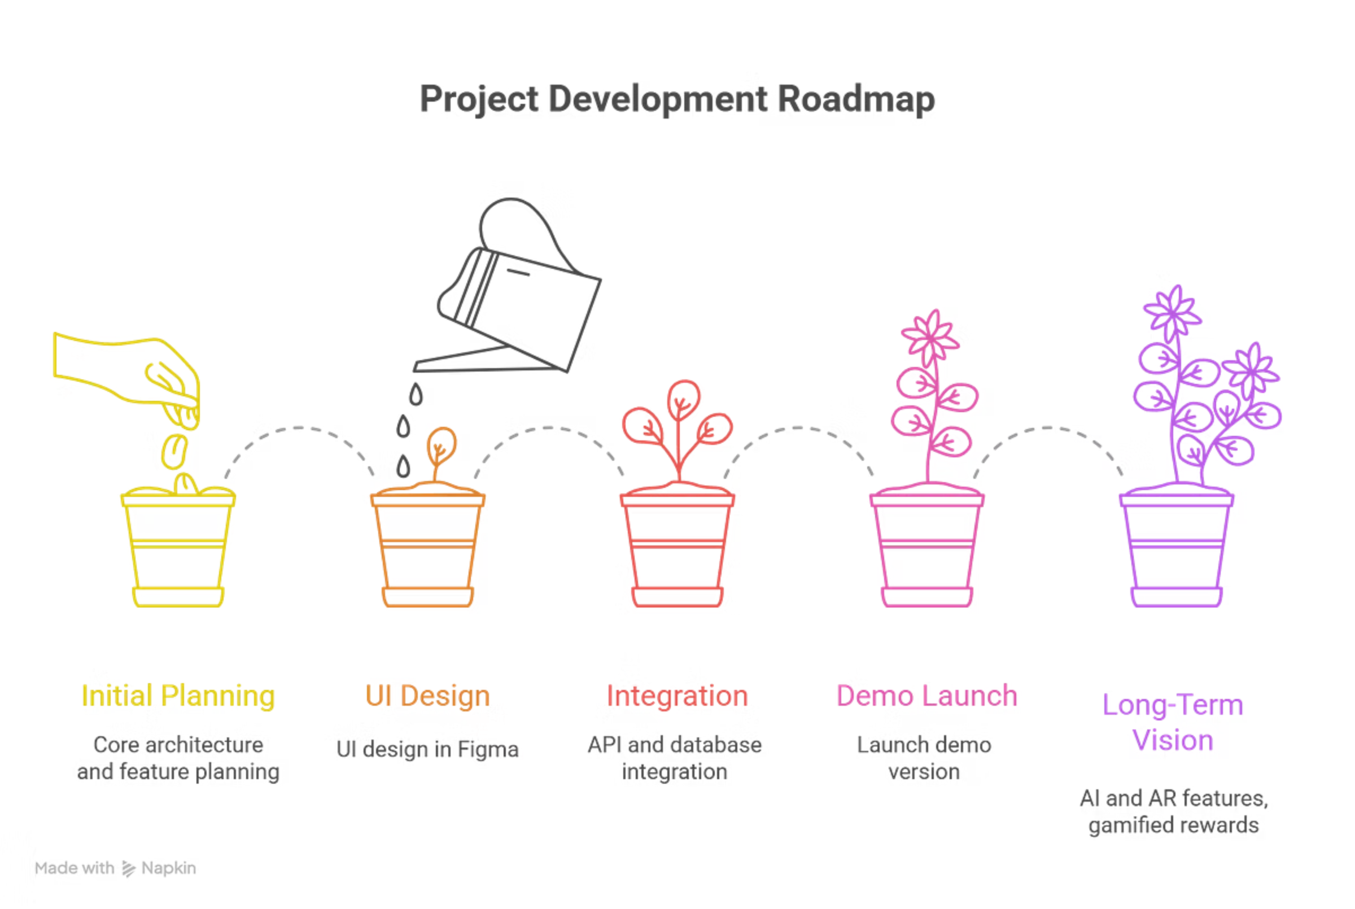



Roadmap:
Built so far:
Next 30 / 60 / 90 days:
Core architecture
Feature planning
UI in Figma
API + database integration
Launch demo
Long-Term Vision:
AI + AR features
Gamified rewards for participation

Slide 10
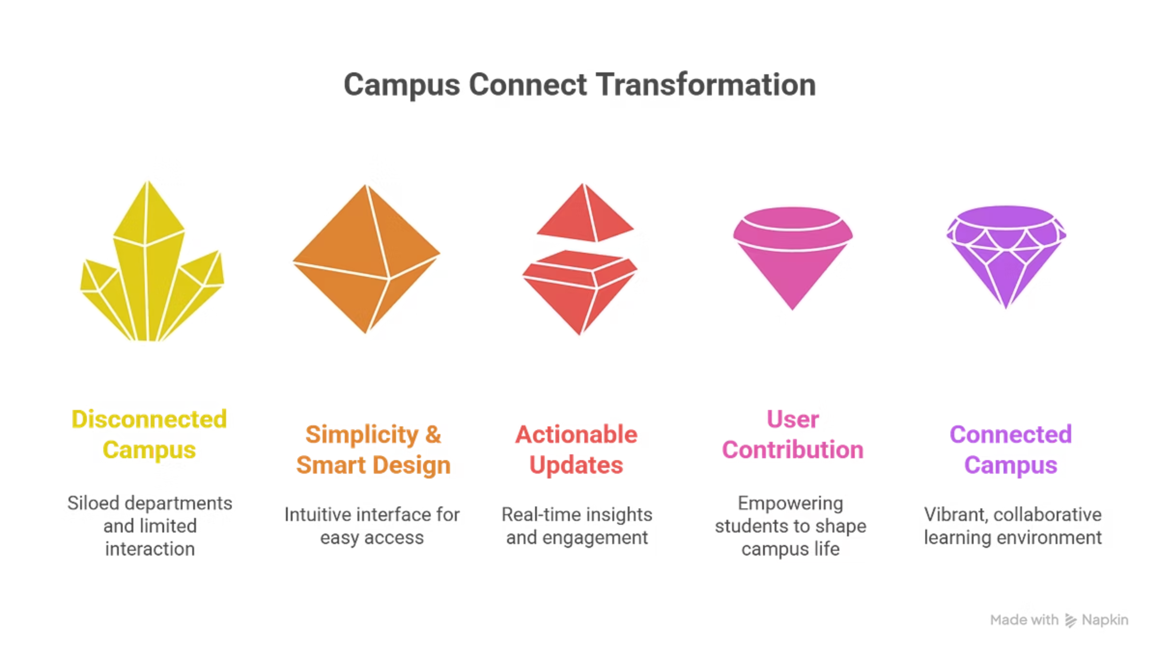
Conclusion:
Campus Connect isn't just about technology — it's about transforming campus culture. It's the bridge between people, places, and possibilities.
By blending simplicity with smart design, it turns every tap into an action, every update into insight, and every user into a contributor to a smarter, greener campus.
This is more than a hackathon project — it's a movement to reimagine campus life and redefine the vibe for the next generation of learners.

Slide 11



Team & Roles:
UI/UX Design
Coding and Integration
Database Management
Vignesh and Sharan Raj
Rajesh and Sharmila
Hariganesh

Slide 12



Ask:
Mentorship & Technical Guidance
Collaboration
Support
With campus innovation labs.
For IoT and AI integration.
To scale post-hackathon.

Slide 13
Thank You
Contact details: vigneshvicky6105@gmail.com, rajeshiyyappan6546@gmail.com, kshanth805@gmail.com, hganesh282@gmail.com, sharanraj674@gmail.com
"Zero chaos. Maximum vibe. Campus Connected."

